Slide 1
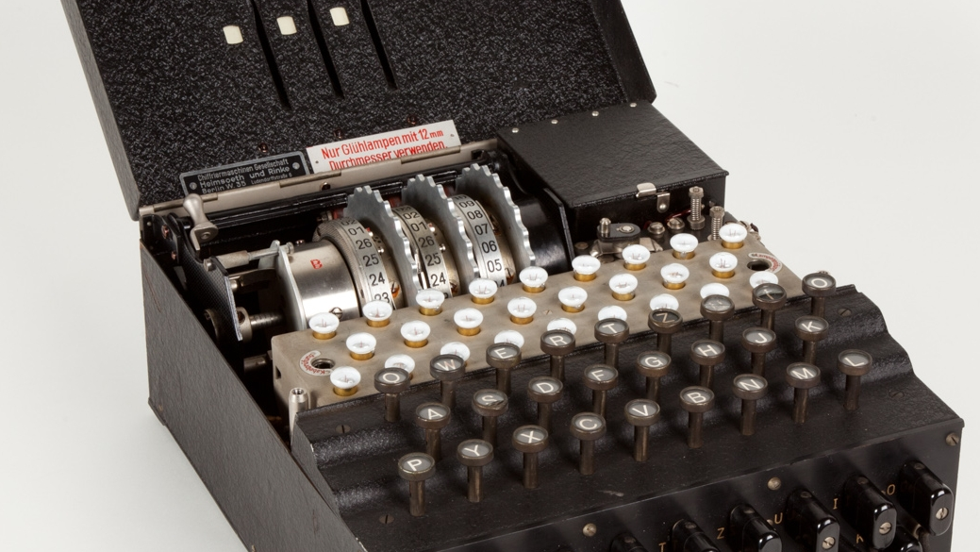
The
Enigma
Machine
21101395 Kwon Jun Hyuk
https://en.wikipedia.org/wiki/Enigma_machine
https://www.youtube.com/watch?v=ybkkiGtJmkM

Slide 2

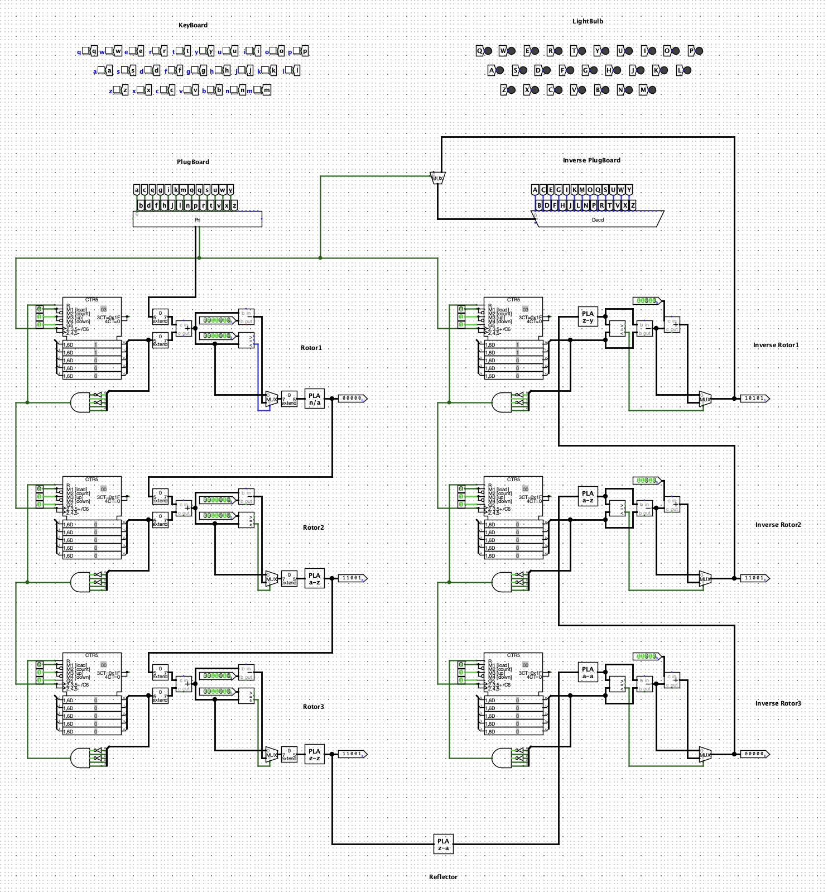
The Enigma Machine
※ Operations ※
To perform encryption, input the plaintext message using the keyboard. The encrypted output will be displayed sequentially through the lightbulb panel.
For decryption, re-enter the encrypted message into the keyboard using the exact same plugboard and rotor settings as used during encryption. The original plaintext will then be output through the lightbulb panel.
To enhance the security of the machine, both the plugboard and the rotors can be reconfigured. The plugboard enables customizable letter-pair substitutions. The rotors themselves can be replaced with different ones, represented by changes in the programmable logic array. Additionally, the rotors can be set to various initial positions, which can be implemented by using counters.
※ Precautions ※
The plugboard and its inverse configuration must be precisely matched to ensure correct encryption and decryption.
M1 [load] should be set to 0, and M2 [count] to 1, M3 [up] and M4 [down] must be set to 1 and 0 respectively. Additionally, G5 Should be set to 1.
A single input pin to each of the adder, subtractor, and comparator units should be initialized to the binary value 11010.
Likewise, the programmable logic array of each rotor must be the exact inverse of that used in its corresponding inverse rotor.
Additionally, the counter value of each rotor must be identical to the state of its corresponding inverse rotor at the time of encryption.

Slide 3
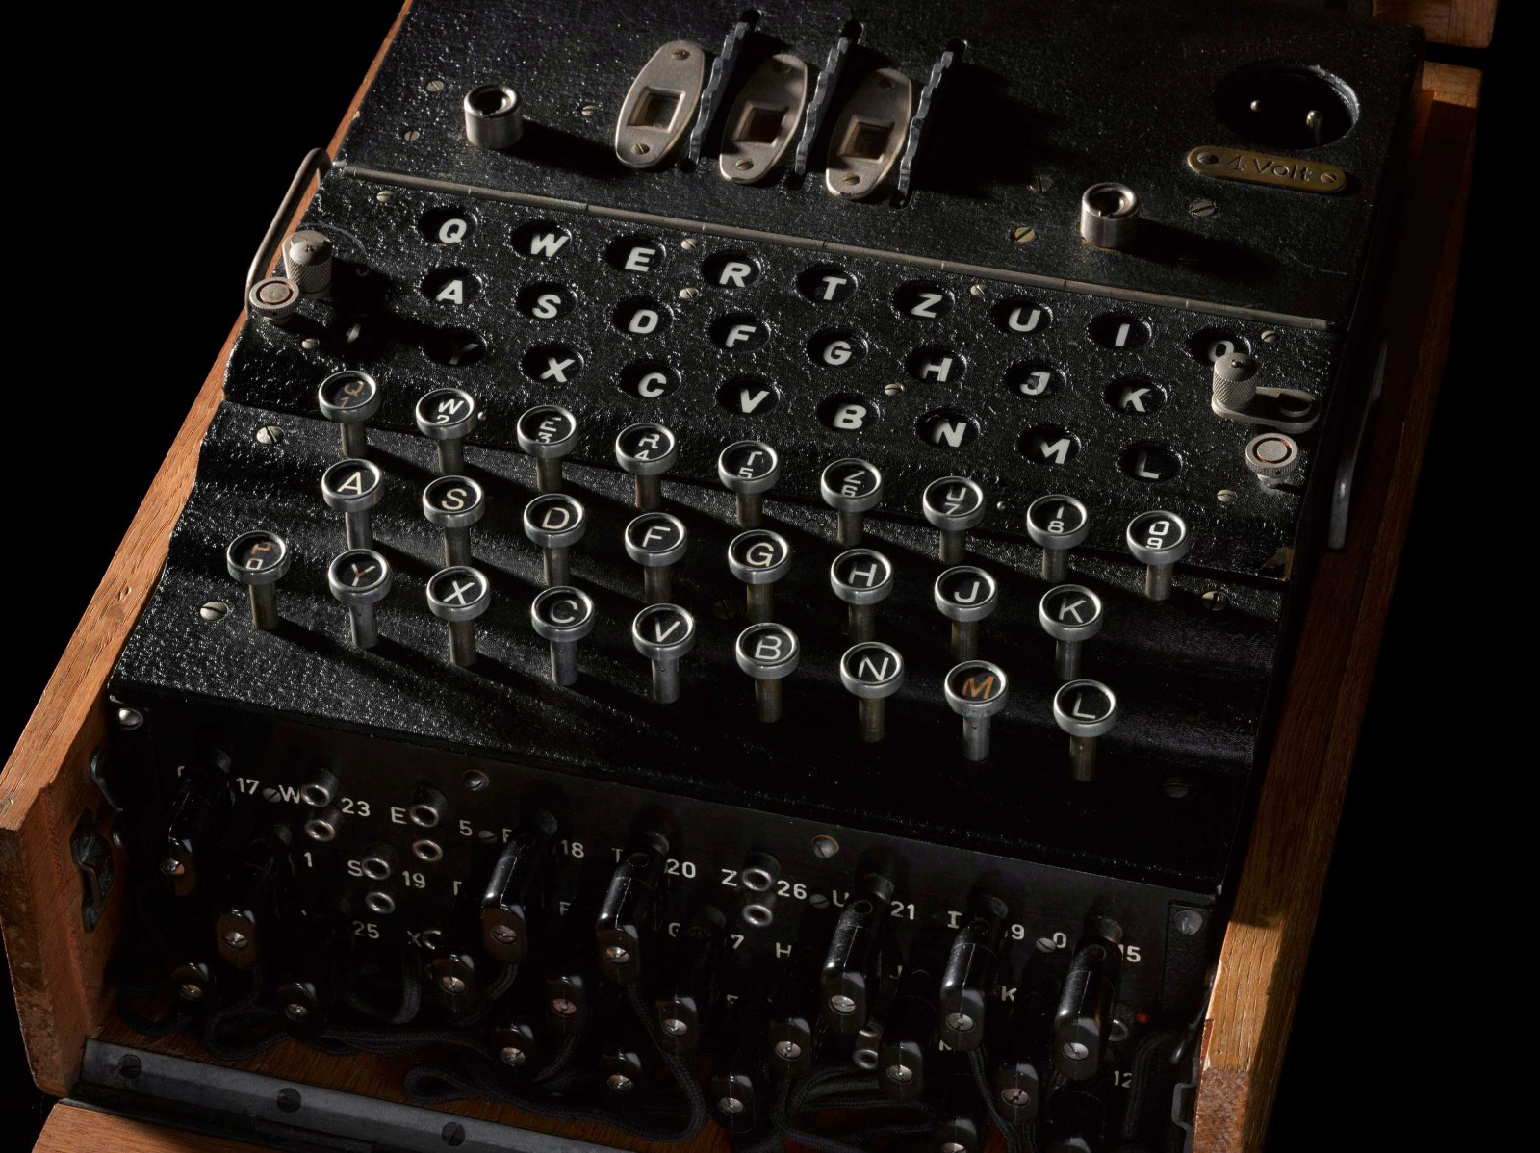
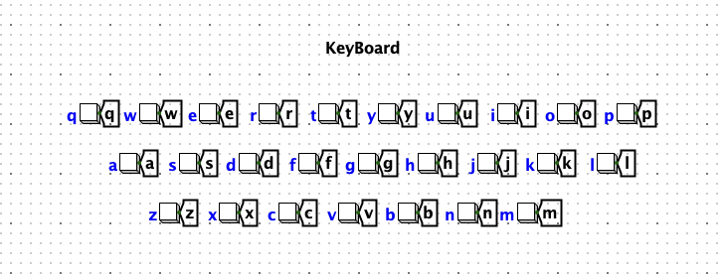
The Keyboard
The keyboard is constructed using button and tunnel circuits.
This channels the alphabetical electrical signals to the plugboard.

Slide 4
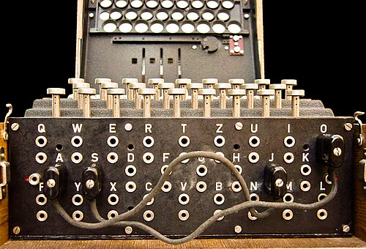
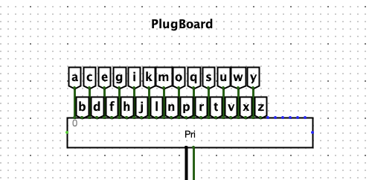
The Plugboard
The plugboard is connected via tunnel and encoder circuits.
This converts the input characters into 5-bit binary data for further processing.

Slide 5
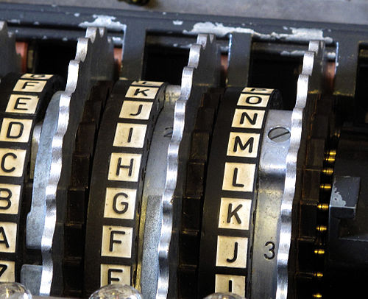
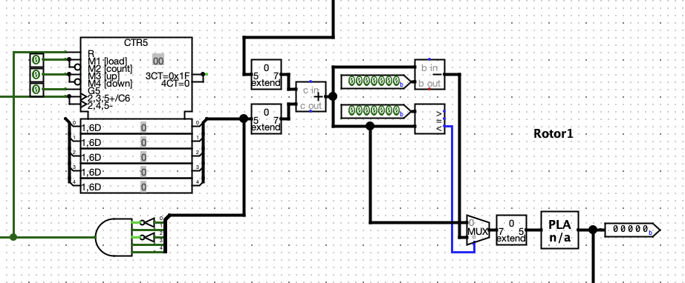
The Rotor
The rotor consists of a counter, bit extender, adder, subtractor, comparator, multiplexer, and a programmable logic array.
The first rotor processes the input received from the plugboard by adding it to its current counter value, which increments with each keystroke. The counter operates on a modulo-26 basis, resetting after completing a full cycle of 26 steps, which is correspondent to the number of letters in the alphabet. The resulting value is then passed through the programmable logic array, producing the final output of the first rotor.
The second and third rotors function in essentially the same manner, with two key differences. First, the input to each rotor is the output from the previous rotor. Second, the counter of each subsequent rotor is incremented once after the previous rotor completes a full 26-step cycle.

Slide 6
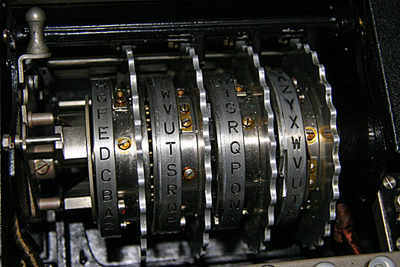

The Reflector
The reflector is implemented using a programmable logic array.
It maps each input character to a different output character in a fixed, symmetrical manner.
For example, if the letter A is mapped to letter B, then letter B is also mapped to letter A.
This ensures that encryption is a reversible process without the need for a separate decryption mechanism.

Slide 7
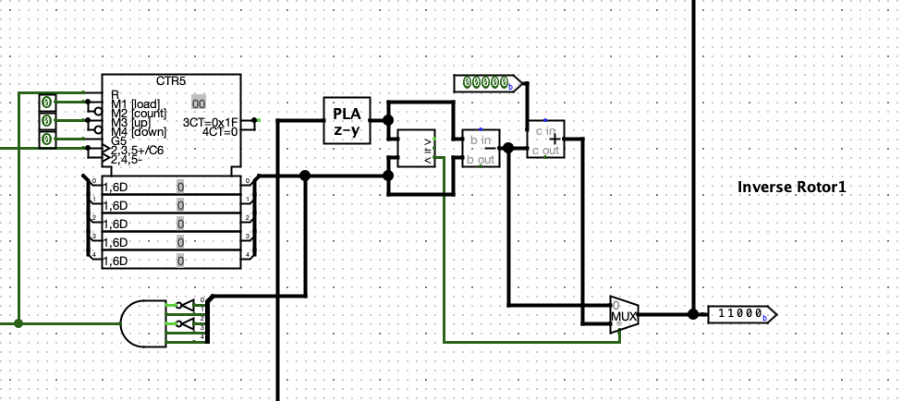
The Inverse Rotor
The inverse rotor also includes a counter, bit extender, adder, subtractor, comparator, multiplexer, and a programmable logic array.
Since the decryption process is the reverse of encryption, the signal passes through the inverse rotors in reverse order, starting with the third rotor. The third inverse rotor receives its input from the reflector. This input is first processed by the programmable logic array, which is configured as the inverse of the third rotor’s original logic array. The output from this stage is then adjusted by subtracting the rotor’s current counter value, producing the final output of the third inverse rotor.
The second and first inverse rotors operate in the same manner. Each receives the output from the previous rotor and uses its corresponding counter value to reverse the transformation.

Slide 8
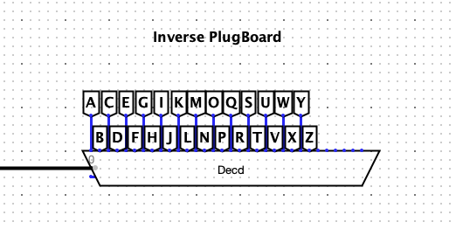
The Inverse Plugboard
The inverse plugboard is made by tunnel and decoder circuits.
It decodes the 5-bit binary input data back into its corresponding alphabetical character.

Slide 9
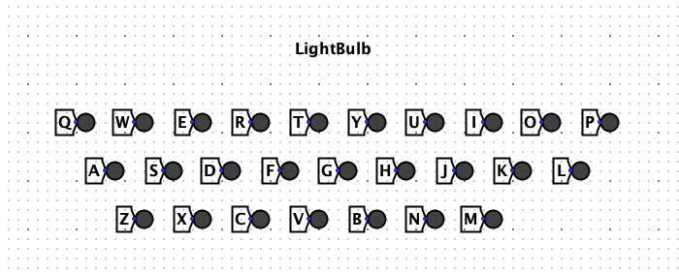
The Lightbulb
The lightbulb is represented by an LED and a tunnel circuit.
This interprets the decoded output and display the corresponding alphabet character visually.

